Slide 1


Poetry , Sound Devices, and Figurative Language
Linda Wickersham​

Slide 2

Literary Devices and Poetry
Writers add richness and interest to their work through literary devices. Poetry (from the Greek word poiesis, "making") means to create a form of LITERARY ART that uses both LITERAL and FIGURATIVE LANGUAGE and evokes strong emotion.
This Greek definition begs the question, IS ALL POETRY ART?
What characteristics most DEFINE POETRY?
It often comes in lines. It often has alliteration, consonance and assonance, parallel devices, meter, rhyme, anaphora, anastrophe, asyndeton and polysyndeton. In other words – SOUND DEVICES.

Slide 3
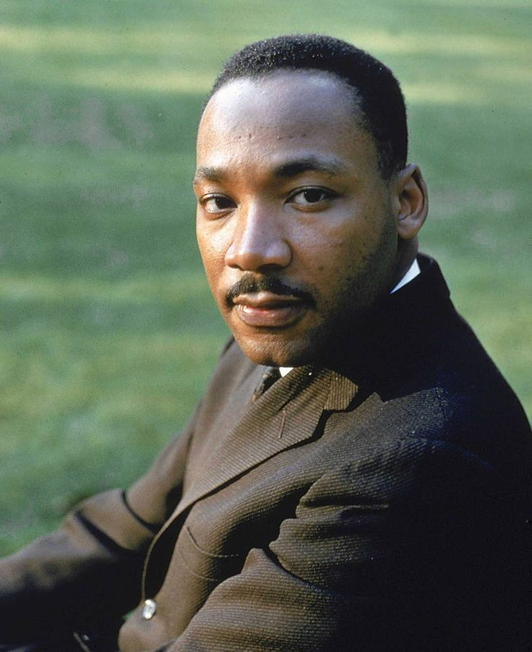
I have a dream that one day down in Alabama with its vicious racists, with its governor having his lips dripping with the words of interposition and nullification, one day right down in Alabama little Black boys and Black girls will be able to join hands with little white boys and white girls as sisters and brothers. I have a dream today.
I have a dream that one day every valley shall be exalted, every hill and mountain shall be made low, the rough places will be made plain, and the crooked places will be made straight, and the glory of the Lord shall be revealed, and all flesh shall see it together.
This is our hope. This is the faith that I go back to the South with. With this faith, we will be able to hew out of the mountain of despair a stone of hope. With this faith we will be able to transform the jangling discords of our nation into a beautiful symphony of brotherhood. With this faith we will be able to work together, to pray together, to struggle together, to go to jail together, to stand up for freedom together, knowing that we will be free one day.
This will be the day when all of God's children will be able to sing with new meaning: My country, 'tis of thee, sweet land of liberty, of thee I sing. Land where my fathers died, land of the pilgrims' pride, from every mountainside, let freedom ring.
And if America is to be a great nation, this must become true. And so let freedom ring from the prodigious hilltops of New Hampshire. Let freedom ring from the mighty mountains of New York. Let freedom ring from the heightening Alleghenies of Pennsylvania. Let freedom ring from the snowcapped Rockies of Colorado. Let freedom ring from the curvaceous slopes of California. But not only that, let freedom ring from Stone Mountain of Georgia. Let freedom ring from Lookout Mountain of Tennessee. Let freedom ring from every hill and molehill of Mississippi. From every mountainside, let freedom ring.
And when this happens, and when we allow freedom ring, when we let it ring from every village and every hamlet, from every state and every city, we will be able to speed up that day when all of God's children, Black men and white men, Jews and Gentiles, Protestants and Catholics, will be able to join hands and sing in the words of the old Negro spiritual: Free at last. Free at last. Thank God almighty, we are free at last.

Slide 4
I am happy to join with you today in what will go down in history as the greatest demonstration for freedom in the history of our nation.
Five score years ago, a great American, in whose symbolic shadow we stand today, signed the Emancipation Proclamation. This momentous decree came as a great beacon light of hope to millions of Negro slaves who had been seared in the flames of withering injustice. It came as a joyous daybreak to end the long night of their captivity.
But one hundred years later, the Negro still is not free. One hundred years later, the life of the Negro is still sadly crippled by the manacles of segregation and the chains of discrimination. One hundred years later, the Negro lives on a lonely island of poverty in the midst of a vast ocean of material prosperity. One hundred years later, the Negro is still languished in the corners of American society and finds himself an exile in his own land. And so we've come here today to dramatize a shameful condition.
In a sense we've come to our nation's capital to cash a check. When the architects of our republic wrote the magnificent words of the Constitution and the Declaration of Independence, they were signing a promissory note to which every American was to fall heir. This note was a promise that all men, yes, black men as well as white men, would be guaranteed the "unalienable Rights" of "Life, Liberty and the pursuit of Happiness." It is obvious today that America has defaulted on this promissory note, insofar as her citizens of color are concerned. Instead of honoring this sacred obligation, America has given the Negro people a bad check, a check which has come back marked "insufficient funds."
But we refuse to believe that the bank of justice is bankrupt. We refuse to believe that there are insufficient funds in the great vaults of opportunity of this nation. And so, we've come to cash this check, a check that will give us upon demand the riches of freedom and the security of justice.
We have also come to this hallowed spot to remind America of the fierce urgency of Now. This is no time to engage in the luxury of cooling off or to take the tranquilizing drug of gradualism. Now is the time to make real the promises of democracy. Now is the time to rise from the dark and desolate valley of segregation to the sunlit path of racial justice. Now is the time to lift our nation from the quicksands of racial injustice to the solid rock of brotherhood. Now is the time to make justice a reality for all of God's children.
It would be fatal for the nation to overlook the urgency of the moment. This sweltering summer of the Negro's legitimate discontent will not pass until there is an invigorating autumn of freedom and equality. Nineteen sixty-three is not an end, but a beginning. And those who hope that the Negro needed to blow off steam and will now be content will have a rude awakening if the nation returns to business as usual. And there will be neither rest nor tranquility in America until the Negro is granted his citizenship rights. The whirlwinds of revolt will continue to shake the foundations of our nation until the bright day of justice emerges.

Slide 5

Because poetry is older than writing, it is an art that is built on sound. Meter is a way to produce a pleasing sound, regardless of the words in the meter. Lines are a way to organize syllables that sound pleasing together, regardless of the meaning of the lines. But when you do add content in the form of figurative language, you create LASTING ART.

Slide 6
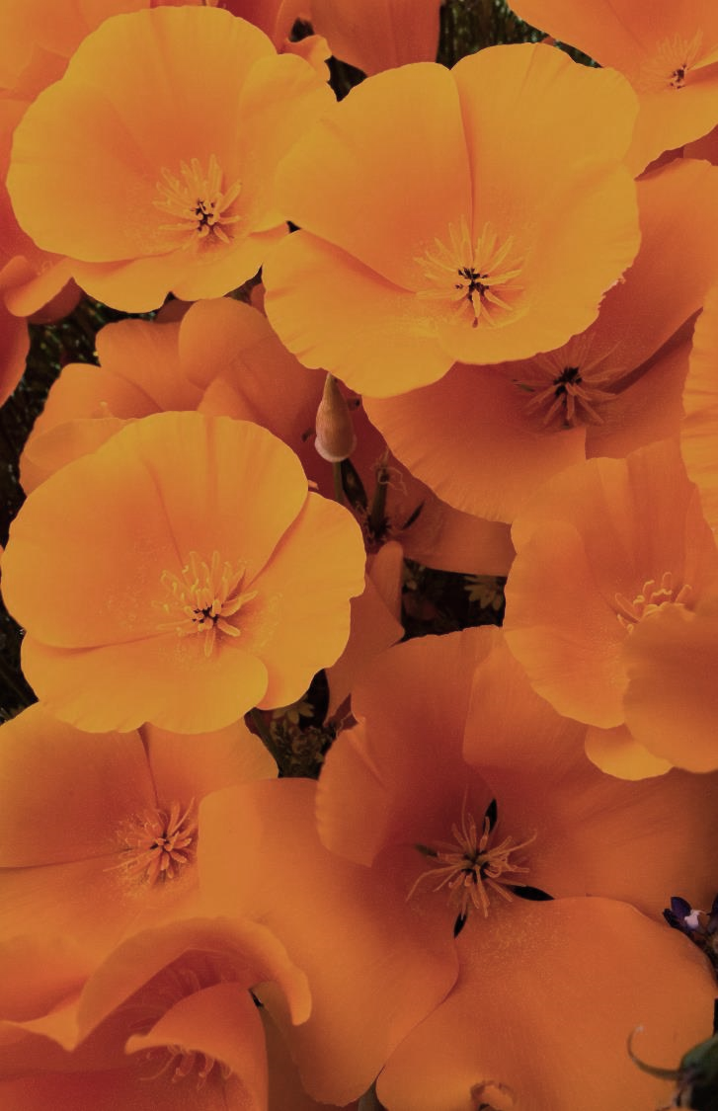
Since the days of Beowulf, the first epic poem written in English, society has proven that they care about the pattern and rhythm of language.
Poetry is older than writing. Scops (Pronounced “shops”) in Anglo-Saxon England and the poets of ancient Greece BEFORE THAT used literary devices to help them remember and recite epic poems.

Slide 7

Poetry should (almost) always be read aloud.
A poet should always read a poem aloud several times before finishing it. You want little chunks of poetry to get stuck in your head, like songs do.

Slide 8
Poetry as Literary Art
The BOTTOM LINE:
POETRY that qualifies as LITERARY ART has a balance of SOUND DEVICES and FIGURATIVE LANGUAGE (metaphors and conceits, imagery, similes, allegory, irony, dramatic irony, situational irony, foreshadowing, in medias res, allusion, anthropomorphism, hyperbole, hypophora, juxtaposition, and many others).

Slide 9
Explication of Example #1
Midterm Break
by Seamus Heaney
I sat all morning in the college sick bay
Counting bells knelling classes to a close.
At two o'clock our neighbours drove me home.
In the porch I met my father crying —
He had always taken funerals in his stride —
And Big Jim Evans saying it was a hard blow.
The baby cooed and laughed and rocked the pram
When I came in, and I was embarrassed
By old men standing up to shake my hand
And tell me they were 'sorry for my trouble'.
Whispers informed strangers I was the eldest,
Away at school, as my mother held my hand
In hers and coughed out angry tearless sighs.
At ten o'clock the ambulance arrived
With the corpse, stanched and bandaged by the nurses.
Next morning I went up into the room. Snowdrops
And candles soothed the bedside; I saw him
For the first time in six weeks. Paler now,
Wearing a poppy bruise on his left temple,
He lay in the four-foot box as in his cot.
No gaudy scars, the bumper knocked him clear.
A four-foot box, a foot for every year.
Literary Devices Used:
Sound Devices
Active Voice (“I sat”)
Consonance “t”; “k” hard “c”; “p”; “f”;
Assonance – “counting bells knelling classes to a close”; drove, home; ambulance arrived; stanched, bandaged; clear, year
Alliteration - “counting, classes, close”
Sibilance – always..funerals…his…stride; standing…shake; tearless sighs; snowdrops…candles soothed…bedside…saw…six
Meter - Iambic Pentameter; blank verse
Types of parallelism:
anadiplosis
epistrophe – “hand” (lines 9 and 12)
anaphora – “And” (lines 6 and 10)
polysyndeton – “cooed and laughed and rocked”; …came in, and I was embarrassed/By old men standing up to shake my hand/And tell me…”
homoeoteleuton – “cooed and laughed and rocked”
Figurative Language and Structure
Conceit (Extended Metaphors)
Coming-of-Age
Circle-of-Life (new baby in the crib; child in a coffin)
Iambic pentameter
Stanzas of 3 lines each – an allusion to 3 being the number of completion with a final stanza of a sole, lone line - finality
Metaphors/Symbols
Handshakes – acknowledgment of adulthood
Candles and flowers – death
“Four-foot box” child death
“No gaudy scar” – tragic accident
College sick bay – childhood trapping; in-between
Images
sat all morning
counting bells knelling
father crying
baby cooed and laughed and rocked the pram
old men standing up
Whispers
mother…coughed out angry tearless sighs
corpse stanched and bandages
snowdrops and candles soothed
paler now
poppy bruise on his left temple four-foot box
bumper knocked him clear
a foot for every year

Slide 10
Example #2
Metaphors
By Sylvia Plath
Sound Devices:
This poem is not dominated with sound devices like a typical
Plath poem is, but we still have plenty:
consonance – “riddle” and “syllables” which also qualifies as
assonance – along with “elephant,” “melon,” “tendrils,” “red,”
“timbers,” “big,” “minted,” “ponderous house,” “ivory,” “fine,” “ “O,” “loaf,” “yeasty,” “I’m,” “means,” ‘I’ve,” “eaten,” “bag,” “apples”
Monosyllabism:
nine house red
fruit fine loaf’s
big new fat
purse means stage
cow calf bag
green train off
Figurative Language:
The title is “Metaphors”; what numerous things is the speaker comparing?
Structure: How is the structure simple yet complex? Why does this matter?
How many predicate nominatives does she give herself? What prepositional or verb phrases follows? (If you were to keep this list going, you would find many more.) riddle in nine syllables
elephant -
ponderous house -
melon strolling on two tendrils
Most importantly, the speaker creates 13 images of herself with some measure of passion. She is begging for us to “get it.” In addition to a riddle, elephant, ponderous house, and melon, she claims to be red fruit, ivory, fine timbers, a [yeasty rising] loaf, a fat purse, a means, a stage, a cow in calf, an [unwise] eater of green apples, and a passenger on a train who has no control over her destiny.
Why? What is she trying to tell us?
It all comes together beautifully when we consider STRUCTURE.
Count the syllables on each line: ______________
Count the lines: ______________
Why is this number important? How is it consistent with the rest of the
poem?
I’m a riddle in nine syllables,
An elephant, a ponderous house,
A melon strolling on two tendrils.
O red fruit, ivory, fine timbers!
This loaf’s big with its yeasty rising.
Money’s new-minted in this fat purse.
I’m a means, a stage, a cow in calf.
I’ve eaten a bag of green apples,
Boarded the train there’s no getting off.

Slide 11

But So What??
So what if we can add or identify fifty literary devices used in a poem. What difference does that make?
The simple answer is that using literary devices or poetic devices in your poetry will not matter until they clearly play a role (i.e., have an effect) on the work.

Slide 12
The Death of Santa Claus
He's had the chest pains for weeks,
but doctors don't make house
calls to the North Pole,
he's let his Blue Cross lapse,
blood tests make him faint,
hospital gowns always flap
open, waiting rooms upset
his stomach, and it's only
indigestion anyway, he thinks,
until, feeding the reindeer,
he feels as if a monster fist
has grabbed his heart and won’t
stop squeezing. He can’t
breathe, and the beautiful white
world he loves goes black,
and he drops on his jelly belly
in the snow and Mrs. Claus
tears out of the toy factory
wailing, and the elves wring
their little hands, and Rudolph’s
nose blinks like a sad ambulance
light, and in a tract house
in Houston, Texas, I'm 8,
telling my mom that stupid
kids at school say Santa's a big
fake, and she sits with me
on our purple-flowered couch,
and takes my hand, tears
in her throat, the terrible
news rising in her eyes.
—Charles Harper Webb
Group Practice
Locate as many sound devices and figurative
language devices as you can find and identify the
effect each device has on the poem, characters, speaker, tone, or something similar.

Slide 13
Beast on a Velvet Chair
(Or Sonnet I)
Slumber befalls him a summer afternoon,
This miniature once-jungled beast.
Dreams of bloodless meals testify
To his life of blue bowls of kibble,
Fish from a tiny tin,
And Amazon-ordered kitty fountain.
Once roused, he’ll stride toward woman;
Scratch him, she will, lest he’ll be
Forced to wreak wrath ‘pon her dwelling.
For she knows the power in his paws, the
Trembling begot by his terrible fangs.
But all will be well between (wo)man and beast,
She knows her place, and the beast knows his.
He peers through slitted eyes, waiting for her to bow.

Slide 14
Final Tips and Takeaways
Remember to read your drafts aloud as you write.
You will amaze yourself at how quickly you learn the most advanced literary techniques once you begin.
Onward!
Draft, draft, and draft again. Sylvia Plath, who won the Pulitzer for her collected poems Ariel in 1964 (posthumously) sometimes worked on a poem for years.
Know which literary devices appeal to you most and work best with your style, but also branch out with every poem.
Remember to use both sound devices and figurative language.

Slide 15
Thank you for listening.
Questions?
Linda Wickersham
lleawickersham@gmail.com

