Slide 1

POETRY
A poet’s work … to name the unnameable, to point at frauds, to take sides, start arguments, shape the world, and stop it from going to sleep. ~Salman Rushdie
St. George’s writers

Slide 2
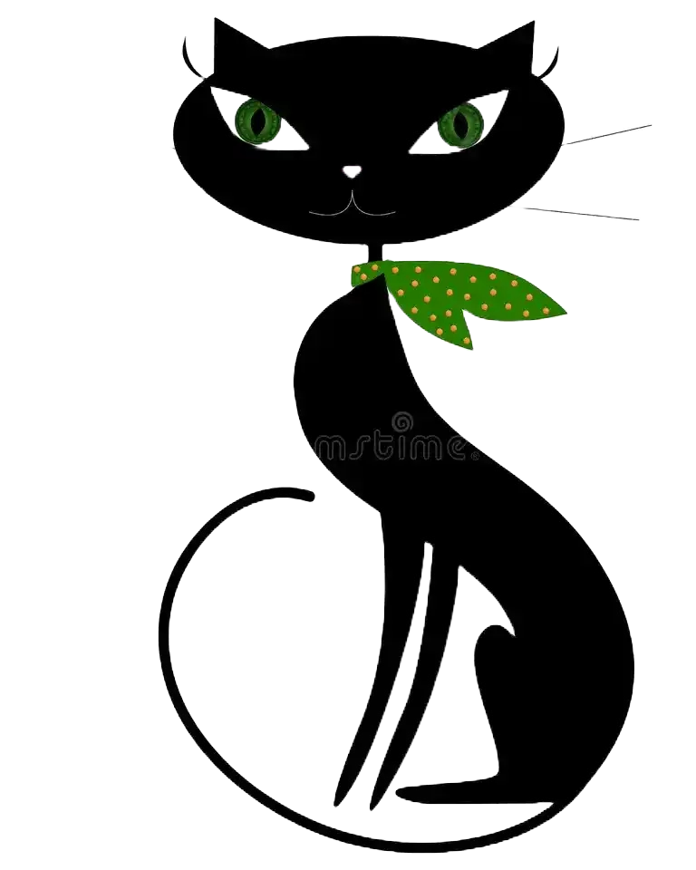
Poetry
Because poetry is older than writing, it is an art that is built on sound. Meter is a way to produce a pleasing sound, regardless of the words in the meter. Lines are a way to organize syllables that sound pleasing together, regardless of the meaning of the lines. But when you do add content in the form of figurative language, you create LASTING ART.

Slide 3
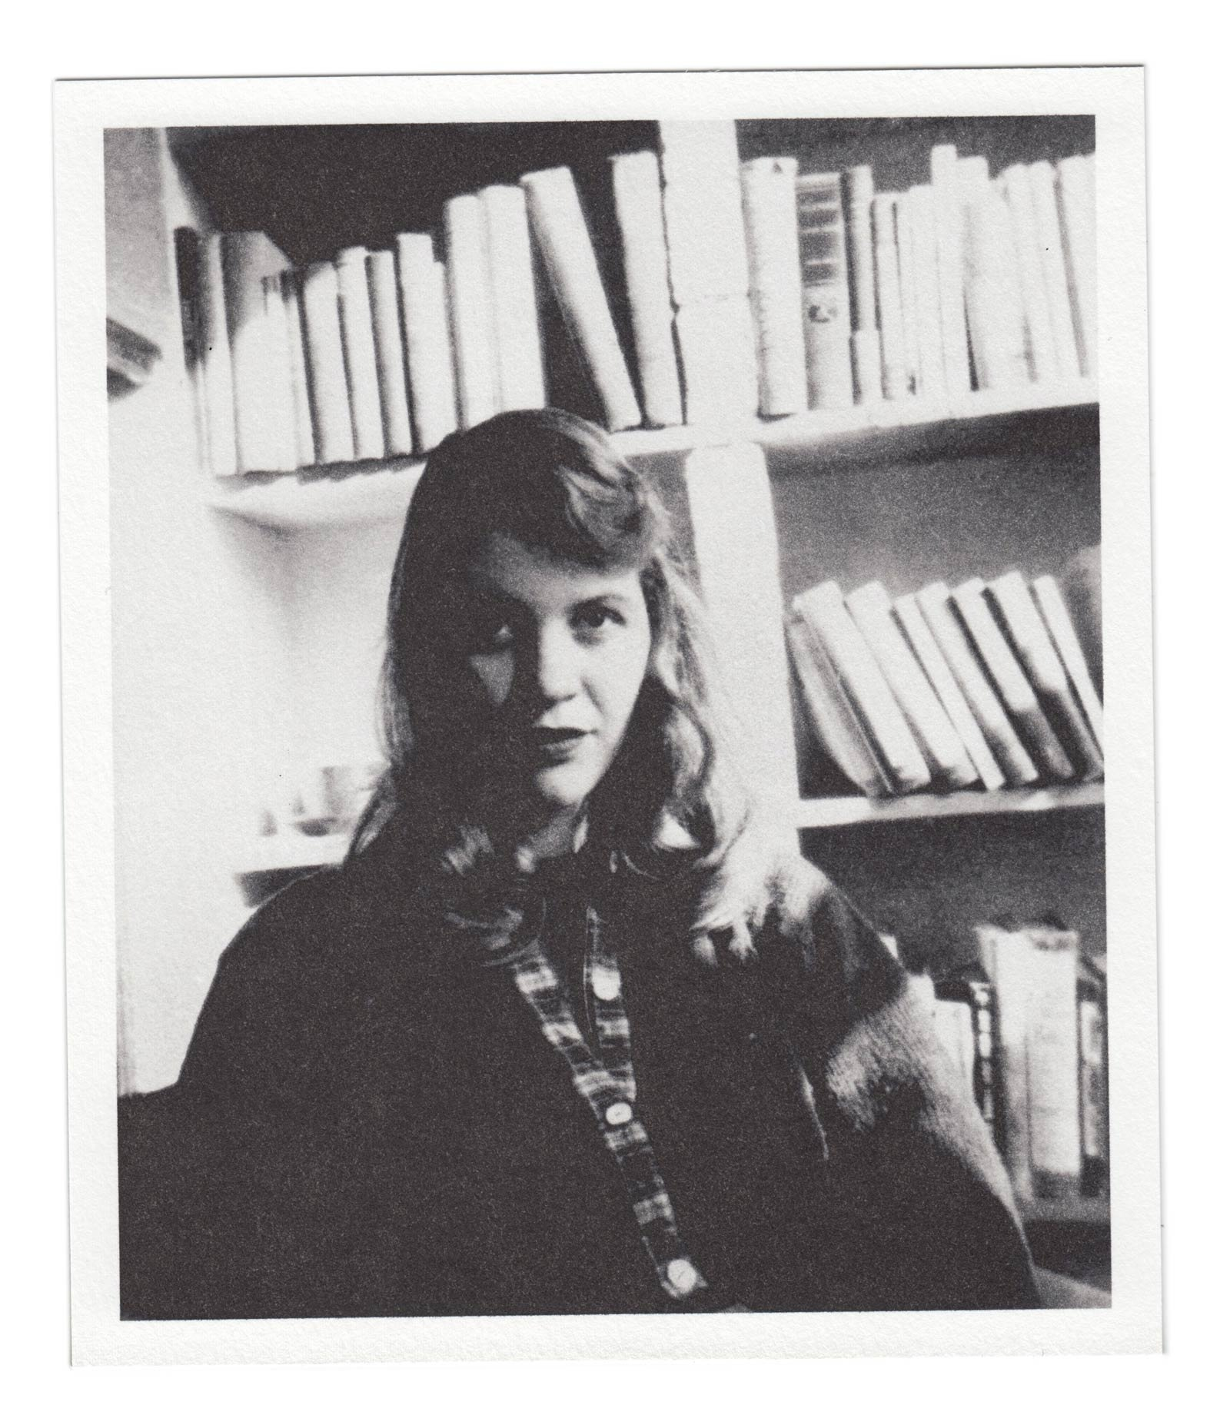
But First, a Recap:
TABLE OF CONTENTS
A Masterful Example
Is All Verse Poetry?
Turning Ponderings Into Poems: Literary Devices
Before and After
Poetry to Go
How has memoir writing been going?
Who has continued?
Has it turned into something different (fiction, an interview, etc.)?
Does anyone want to share?
Sylvia Plath is best known for her semi-autobiographical novel, The Bell Jar, but she won the Pulitzer Prize for Ariel, a volume of poetry published after her death in 1964.

Slide 4
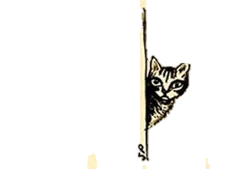
ELLA MASON AND HER ELEVEN CATS by Sylvia Plath
Old Ella Mason keeps cats, eleven at last count,
In her ramshackle house off Somerset Terrace;
People make queries
On seeing our neighbor's cat-haunt,
Saying: ‘Something's addled in a woman who accommodates
That many cats.’
Rum and red-faced as a water-melon, her voice
Long gone to wheeze and seed, Ella Mason
For no good reason
Plays hostess to Tabby, Tom and increase,
With cream and chicken-gut feasting the palates
Of finical cats.
Village stories go that in olden days
Ella flounced about, minx-thin and haughty,
A fashionable beauty,
Slaying the dandies with her emerald eyes;
Now, run to fat, she's a spinster whose door shuts
On all but cats.
Once we children sneaked over to spy Miss Mason
Napping in her kitchen paved with saucers.
On antimacassars
Table-top, cupboard shelf, cats lounged brazen,
One gruff-timbred purr rolling from furred throats:
Such stentorian cats!
With poke and giggle, ready to skedaddle,
We peered agog through the cobwebbed door
Straight into yellow glare
Of guardian cats crouched round their idol,
While Ella drowsed whiskered with sleek face, sly wits:
Sphinx-queen of cats.
‘Look! there she goes, Cat-Lady Mason!’
We snickered as she shambled down Somerset Terrace
To market for her dearies,
More mammoth and blowsy with every season;
‘Miss Ella's got loony from keeping in cahoots
With eleven cats.’
But now turned kinder with time, we mark Miss Mason
Blinking green-eyed and solitary
At girls who marry—
Demure ones, lithe ones, needing no lesson
That vain jades sulk single down bridal nights,
Accurs’t as wild-cats.
Curious French Cat, drawing by Sylvia Plath,
1956

Slide 5
What converts reflections or verses to actual poetry?
LITERARY DEVICES: FIGURATIVE LANGUAGE AND SOUND DEVICES
https://literarydevices.net/
.
“Ella Mason” is rich with sound devices and figurative language that Plath uses to develop her theme:
1. Who is the speaker?
2. What happens in this poem? It’s a narrative, so be sure you know the story, then return to the language to analyze how it contributes to telling the story.
3. Find the following devices Plath has used abundantly and discuss the effect they have:
4. What thematic idea does Plath develop in “Ella Mason and Her Eleven Cats”?
Alliteration, assonance, consonance, imagery, sibilance, parallelism (various forms), kenning, homoeoteleuton, allusion, dialogue, characterization, high diction, voice, conceit

Slide 6
Your Turn: What’s on your mind today? Don’t worry about literary devices for your first draft; just get thoughts onto page.

Slide 7
The fractures of your soul pierced my light
and gleans in echoes of timelines traveled
As I walked through the blooms of hel
Perfumed in the threads of our story
My wounds dripped. My wounds –
Stripped and bared –
In the twilight of falling tears.
Jumble of junk

Slide 8
Y’all.
I know y’all love him like I do. More than I do, even.
Boy-man that he is, what is he thinking? Is that it,
Y’all? His thinking? His mind, his brain, his sideways logic,
His long-way ‘round, His DNA, his father’s blood?
Y’all could blink your eyes and make him well. Or twinkle your nose
(I’ve always been a twinkle-your-nose fan). But fuck it. Free will.
Y’all see his future: can I bear it? Can my mother’s heart hold what’s
To come, and hold his hand, and hold myself together for the older
One, for everyone who’s inched me along during the bad, and then
Worse, and then worst?
Y’all have seen some things: driving demons out of pigs, a tower of babblers, and my favorite – blinding Paul to make him listen.
Do y’all still do that – blind people to improve them?
Maybe just this once?
Not forever. Just to fix him.
Never mind. I don’t even like Paul.
But Y’all, I can’t. My heart cannot witness him locked away,
Yet how can he get better without heavy doors between us?
Y’all, tell me how I can bear his adult-infant screams when I leave?
But how can I stay when he thinks Steve and Barack and Warren
Are on their way to meet him?
But really, Y’all, I see it so clearly.
He’s huddled on the sidewalk, his dog, old and cloudy-eyed
Beside him, both alert to anyone who walks by dropping kindness.

Slide 9
TIME TO WRITE: PUT SOME VERSES DOWN ON PAPER AND TOGETHER WE WILL APPLY SOME LITERARY DEVICES.

Slide 10
Y’all.
I know y’all love him like I do. More than I do, even.
Boy-man that he is, what is he thinking? Is that it,
Y’all? His thinking? His mind, his brain, his sideways logic,
His long-way ‘round, His DNA, his father’s blood?
Y’all could blink your eyes and make him well. Or twinkle your nose
(I’ve always been a twinkle-your-nose fan). But fuck it. Free will.
Y’all see his future: can I bear it? Can my mother’s heart hold what’s To come, and hold his hand, and hold myself together for the older
One, for everyone who’s inched me along during the bad, and then
Worse, and then worst?
Y’all have seen some things: driving demons out of pigs, a tower of babblers, and my favorite – blinding Paul to make him listen.
Do y’all still do that – blind people to improve them?
Maybe just this once?
Not forever. Just to fix him.
Never mind. I don’t even like Paul.
But Y’all, I can’t. My heart cannot witness him locked away,
Yet how can he get better without heavy doors between us?
Y’all, tell me how I can bear his adult-infant screams when I leave?
But how can I stay when he thinks Steve and Barack and Warren
Are on their way to meet him?
But really, Y’all, I see it so clearly.
He’s huddled on the sidewalk, his dog, old and cloudy-eyed
Beside him, both alert to anyone who walks by dropping kindness.

