Slide 1
Telling Our Stories

Slide 2
Telling Your Story

Slide 3
Storytelling and Spirituality
How is storytelling spiritual?
Telling our stories for those who come after us is an act of love – a spiritual act.
Think of your loved ones who didn’t leave you or your family members their recorded stories. How much would you treasure such a thing if it were possible to have it? Writing your story for those who come after you leaves behind great treasure and blessing.

Slide 4

In Medias Res
If I asked you to tell me a story that captured the essence of who you are, would you tell me the story of your birth? Do you remember the story of your birth?
Few of us have birth stories so compelling that we should begin our narratives there.
Instead, most writers find in medias res much more effective. In medias res means starting in the middle of a story, then going back to the beginning to explain the context before continuing.

Slide 5
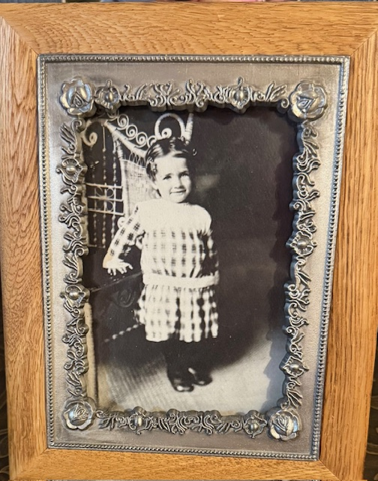
On your handout, read the openings to the seven memoirs and choose your two favorites. Be ready to discuss why you made your choices.

Slide 6
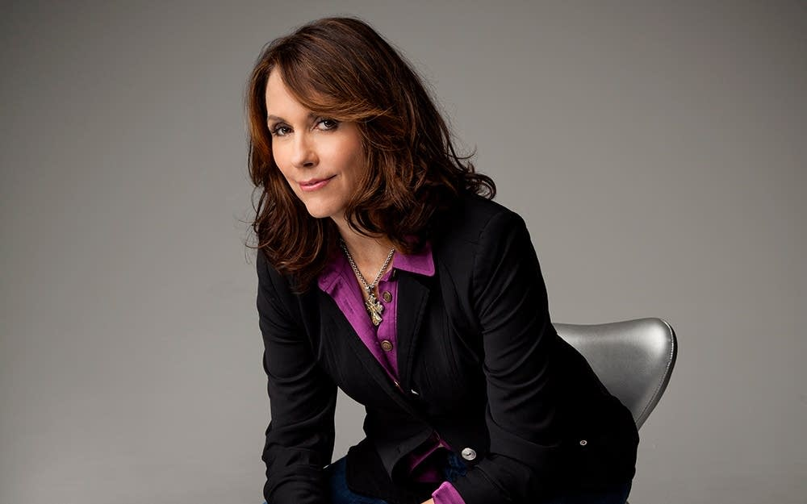
ADVICE FROM MARY KARR
Work on expressing inner truth from the beginning and your voice will develop more naturally.
Check with others before you write about them if any controversy could arise. People remember things differently.
Don’t use labels to describe yourself or someone else. For example, instead of saying, “She was a terrible alcoholic,” you might say, “She drank heavily and often.”
As a general rule, have one or two trusted readers during your writing process, but keep your writing to yourself during the creating stage.
A structure that works well is to begin in medias res, then flesh out the story.
Always have a notebook at hand so you can write down ideas and thoughts as they come to you.
Writers write. In other words, write much more than you will ever use. It will help you get better, just like using your physical muscles helps you get stronger.
Use stream-of-consciousness to make your writing authentic and interesting. What is stream-of-consciousness? It is real life: it is the process of one thought leading to another, and then another, and so on, and then returning to your original point. It makes for good reading.

Slide 7
Ponder a moment. What one or two stories come to mind that illustrate the essence of you, who you are and what has molded you into who you’ve become?
Your story might be funny, sad, dramatic, serious, or -- best of all – all these things.

Slide 8
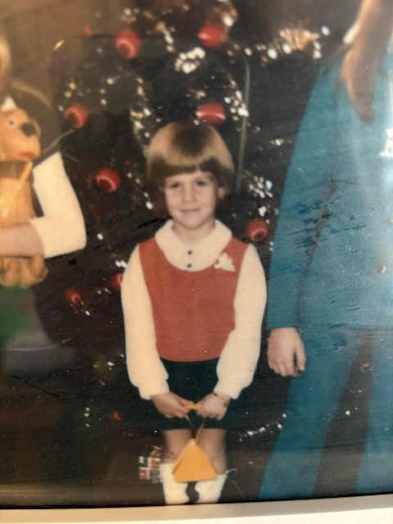
When I was eight-years-old, I almost killed my four-year-old sister, despite spending most of my waking hours guarding her against threats of every kind. I was quite concerned about our mother’s lack of worry over cliffs Kathy could fall over. Or that she could disappear into the potential quicksand that could appear at any moment in our back yard. And what about the cobras? I always kept a diligent eye out for cobras.
What I didn’t plan on getting past me was electricity.
We had been dancing to records on the portable player, and we decided to put it away and do something else. Mom had taught us well. Put up the first thing before getting out the second thing. I gathered the records while Kathy unplugged the player
But the plug wouldn’t come out of the socket. No matter how we pulled with our sweaty little hands, in it stayed. So I uttered the fateful words:
“Get a knife from the silverware drawer and wiggle it out.”
In retrospect, I knew even then that it was a bad idea. I could see our older sister, who was far too cool to play with us, smirk a little.
When knife touched plug, Kathy flew through the air. She landed across the room. For a long moment I thought she was dead. I think she thought she was dead. But she found her voice and started to cry. I hadn’t killed her. I could still protect her from all the dangerous things in the world.

Slide 9


Don’t try to edit yourself as you go – just write. As Faulkner said, when a story needs to be told, the writer must just get out of the way. “If a story is in you, it has to come out.” Let the story come out and worry about editing it later.
Use photos to spark memories.
If you’re telling someone else’s story, or integrating the stories of others into yours, record them so that you can refer to them repeatedly.
Read your story aloud to yourself often, even if it seems awkward at first. You will catch the weak points.

Slide 10
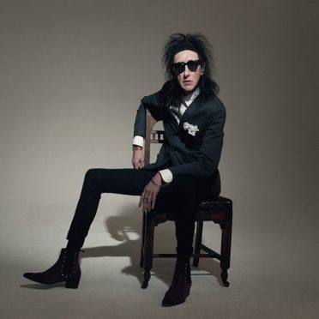
Bonus Material
https://www.youtube.com/watch?v=3plAkS7uhI4

Slide 11

Thank You
Linda Wickersham
Wickershamwriting.com

Slide 12
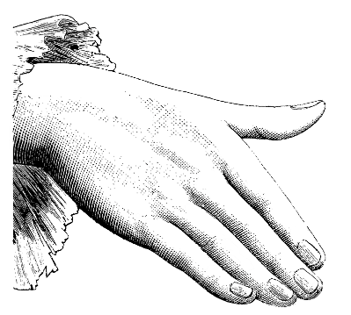
Information and Decisions

